Slide 1
Art of China
From Neolithic times through the Han Dynasty
3000 BCE – 226 CE
Plus Calligraphy and Chinese Brush Painting

Slide 2
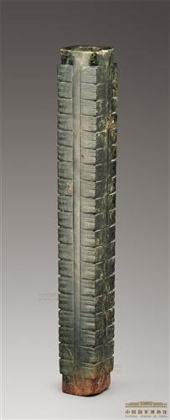
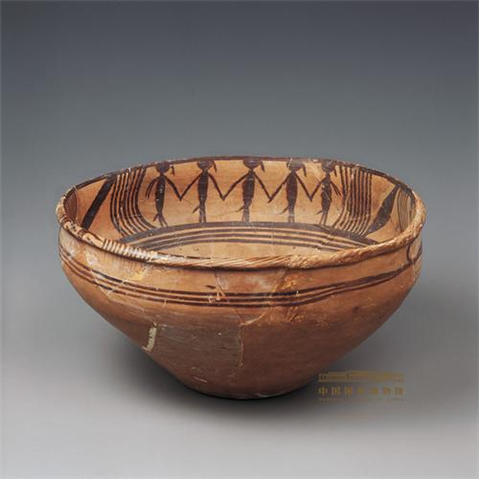
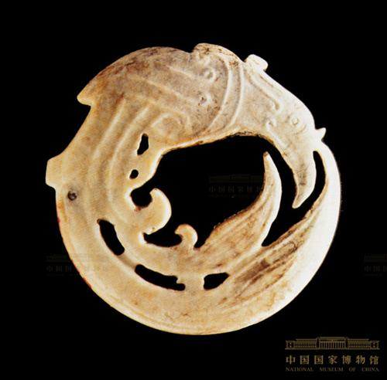
Neolithic Pottery & Jade
Can you name this fiery bird?
Phoenix
Basin with design of dancers
Neolithic, (4700 – 4400 BCE)
Majiayao Culture, Qinghai Province
Jade piece 5 cm diameter
Neolithic, (4700-4400 BCE)
Shijahe Culture
Jade cong with head of an immortal, Neolithic, (5300-4200 BCE)
Liangzhu Culture
Notes:
This piece is made from fine red clay with a restrained mouth, rolled lip and slightly convex belly tapering to a small circular base. It has been decorated with black paint. The outside has a simple design of three lines, but on the inside similar lines frame a painting of three groups of dancers. Each group comprises five figures holding hands. Their hair is braided and a decoration hangs from their body. The braid and decoration fall on different sides of each figure, giving a sense of movement to the group. The outer arm of the outer two figures of each group is painted with two lines, perhaps to express the swaying of their arms during the dance. A wonderful feature of this bowl is that, when it is full of water, the ripples of the water imbue the painted figures with a sense of movement, so that they appear to be dancing. Many scholars have studied this scene, offering different interpretations. Some suggest that it is a hunting dance, some a religious dance, others a ceremonial dance, yet others hypothesize that the aim of the dance is for a bumper harvest. (Yu Lu) Second piece is Jade Phoenix, legend holds that when this bird dies it collapses in flames and is reborn from it’s ashes, a powerful symbol for the Chinese afterlife. 2nd piece Jade decorative piece - Stylized features – jade is a very hard stone – carved by using an abrasive paste that is rubbed on the stone to wear away a pattern or image, until the bronze age when the jade could be etched and sculpted. Jade is a symbol of wealth, virtue and honor.3rd piece - Jade cong with head of an immortal, Neolithic, Liangzhu Culture(5300-4200BC), Height 49.2 cm, Width at top 6.4 cm, Width at bottom 5.6 cm In form, a cong is a tube with a circular inner section and squarish outer section. The outer surface is divided vertically or horizontally such that the whole defines a hollow cylinder embedded in a partial rectangular block. Proportions vary - a cong may be squat or taller than it is wide. The outer faces are sometimes decorated with mask-like faces, which may be related to the taotie designs found on later bronze vessels. Although generally considered to be a ritual object of some sort, the original function and meaning of the cong are unknown. Later writings speak of the cong as symbolizing the earth, while the bi represents the heavens. The square represents the earth and a circle represents the heavens.

Slide 3
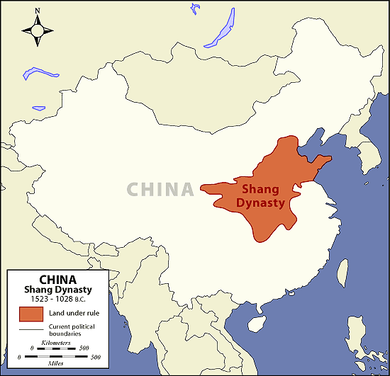
Modern China Shang Dynasty
Notes:
Left Map give current borders and surrounding nations as we know today. During the Neolithic times the earliest Chinese civilizations developed around the Huang He or Yellow River valleys. Leading to what many consider the first dynasty the Xia (roughly 2070-1600 BCE, but with no written histories little is still known. As a people they were mainly an agricultural based society, but did create early bronze vessel and plates around 1700 BCE and fairly sophisticated pottery and stoneware. Pottery was watered before removing from kiln leading to mainly black or gray color, but were often decorated with beautiful patterns in rope,, feather or nailing patterns. The Shang Dynasty is known for the first Chinese script, earliest surviving literature (1000BCE) the beginnings of urban life and sophistication of bronze work and eventually iron work around 650 BCE.

Slide 4
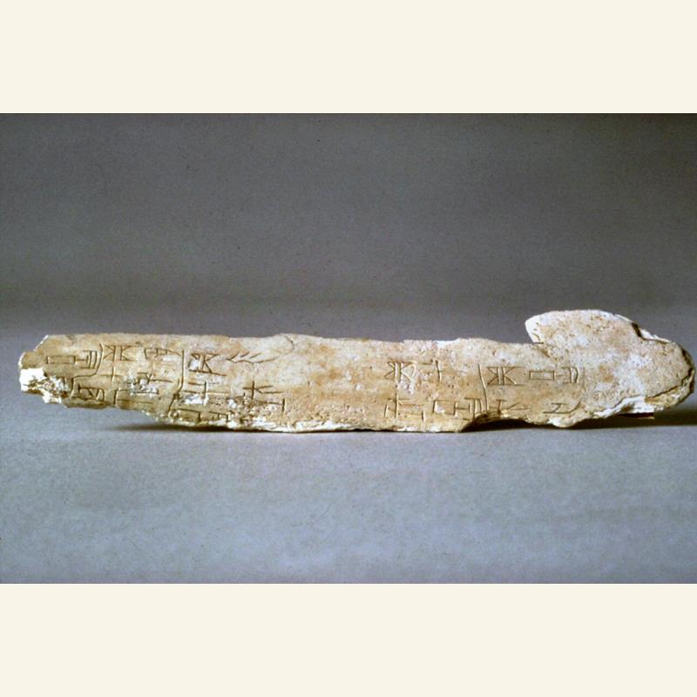
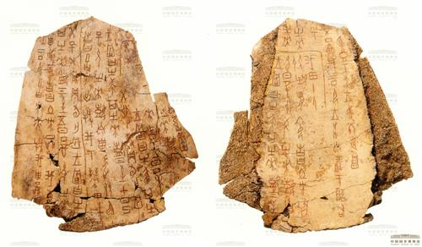
Shang Dynasty c. 1600 – 1046 BCE
What animals do you think these bones came from?
Cattle bone/scapula
Turtle Plastron
Oracle bone Shang approx. 1300-1050 BCE
1 1/8” x 6”
Oracle bone recording the invasion of the Tufang peoples
Shang（1600-1046 BCE）
Notes:
Oracle bones are inscribed turtle plastrons and animal bones dating from the Shang period. The inscriptions recorded the divination of the Shang kings and reveal aspects of politics, economics, military affairs, culture and society and make them a very valuable historical source. They were found in the site of the last capital of the Shang dynasty, Yinxu, near Anyang in Henan Province. Shang priests would take bones, write questions on them, and heat a metal needle against back of bone. Cracks developed which would be interpreted as answers. Those answers were then written on the bones. The nearly 10,000 oracle bones that have been discovered provide a wonderful record of Shang life since rulers as well as commoners used this type of divination. 1st image – Probably cattle bone/scapula - The fragment reads “The Gongfang will not go on a great campaign [against us]. We should order ‘Attack the Gongfang.’ We should not order ‘Attack the Gongfang.’ On the next day, it will perhaps rain.”
2nd Image - The long inscription on both sides of this oracle bone consists of 170 characters, inscribed vertically and highlighted with cinnabar: the colour remains vivid. The inscription records various matters including a kingly edict for a hunt by the feudal lords, celestial phenomenon and an invasion. It is an important source for the study of Shang society and the history of astronomy. (Han Fulin)

Slide 5
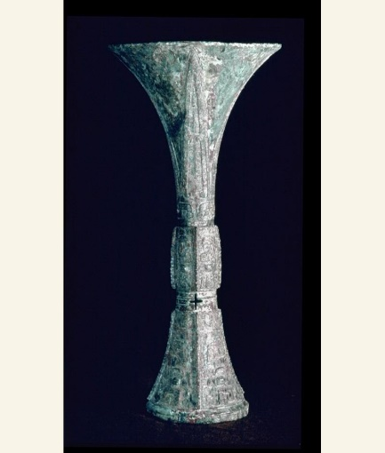
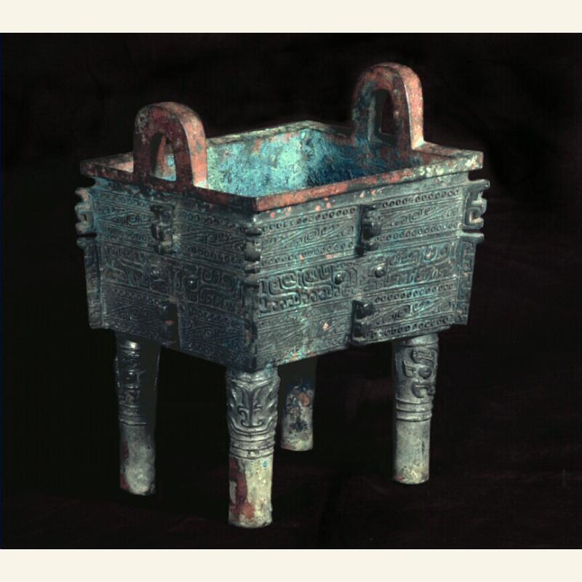
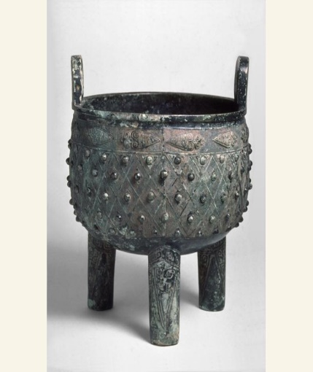
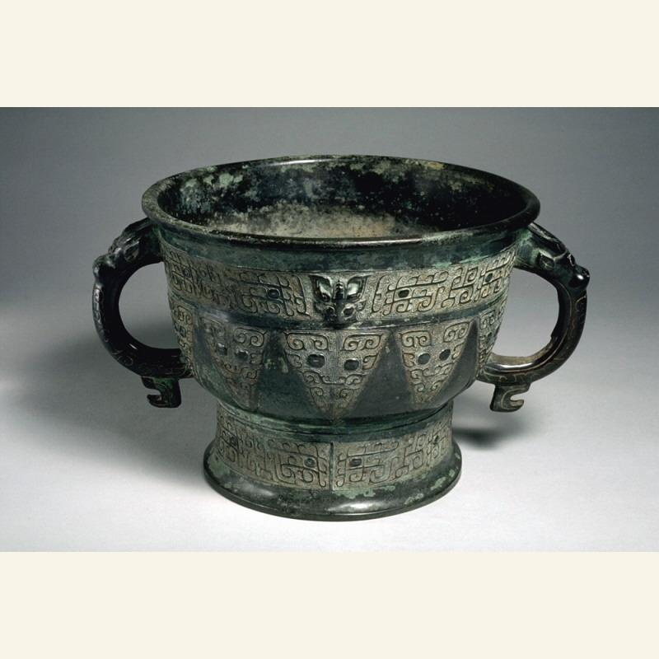
Shang Dynastry – China’s Bronze Age
Chinese bronze artifacts generally are:-
utilitarian, like spear points, tools or adze heads,
"ritual bronzes", which are more elaborate versions in precious materials of everyday vessels, tools and weapons.
Ding (food vessels) could also show political control of areas, who ever possessed the regional ding was the ruler.
Ritual Wine Vessel (Gui) Ca. 1300 – 1050
Ritual Wine Vessel (Gui) (Ca. 1200 – 1050 BCE
Ritual Food Vessel (Ding)
Ca. 1200 – 1050 BCE
Ritual Food Vessel (Fangding)
Ca. 1400-1300 BCE
Notes:
Unlike early Greek and Roman art, humans are rarely portrayed on pottery or bronzes. The majority of pieces found are of ritual vessels for offerings or animals, food or drink and were larger than those used for everyday. Then they could be added to burial tombs to continue their worship in the afterlife. The more politically important or wealthy the individual or family the more bronze objects they could afford. In China, the greatest part of discovered and preserved bronze items was not forged to ploughs or swords but cast to sacrificial vessels. Even a great part of weapons had a sacrificial meaning like daggers and axes that symbolized the heavenly power of the ruler.
1) ) Dagger (Sackler object F1 953.62) Shang ca. 1600 – 1050 BCE 23.6 cm x 6.8 cm. Very elaborately decorated – may have been ceremonial. Likely belonged to a noble. The dragon was a popular Shang image as it represented power Bronze 2) Animal face ax Late Shang (1300–1046 BCE ) Length 31.7 cm, Width 35.8 cm Excavated in 1965 from Subuchun, Yidu(present-day Qingzhou), Shandong Province, perhaps early Taotie design – The Taotie (Chinese: 饕餮; pinyin: tāotiè; sometimes translated as a gluttonous ogre mask) is a motif commonly found on Chinese ritual bronze vessels from the Shang and Zhou Dynasty. The design typically consists of a zoomorphic mask, described as being frontal, bilaterally symmetrical, with a pair of raised eyes and typically no lower jaw area. Some argue that the design can be traced back to jade pieces found in Neolithic sites such as the Liangzhu culture (3310–2250 BCE).[1] (source) Kesner, Ladislav (1991). The Taotie Reconsidered: Meaning and Functions of the Shang Theriomorphic Imagery. 51, No. 1/2. Artibus Asiae. pp. 29–53 The Chinese bronze artifacts generally are either utilitarian, like spear points or adze heads, or "ritual bronzes", which are more elaborate versions in precious materials of everyday vessels, as well as tools and weapons. Examples are the numerous large sacrificial tripods known as dings in Chinese; there are many other distinct shapes. Surviving identified Chinese ritual bronzes tend to be highly decorated, often with the taotie motif, which involves highly stylized animal face(s). These appear in three main motif types: those of demons, of symbolic animals, and of abstract symbols.[31] Many large bronzes also bear cast inscriptions that are the great bulk of the surviving body of early Chinese writing and have helped historians and archaeologists piece together the history of China, especially during the Zhou Dynasty (1046-256 BC)

Slide 6
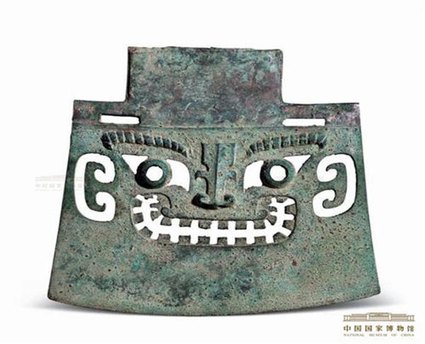
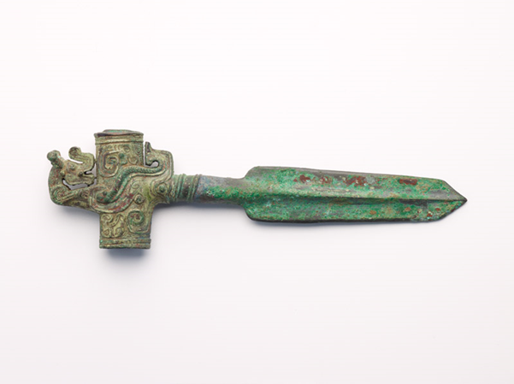
Left: bronze dagger ca. 1600-1050 BCE Dragon design
Above: Animal face ax ca. 1300-1046 BCE Taotie or Ogre mask design

Slide 7
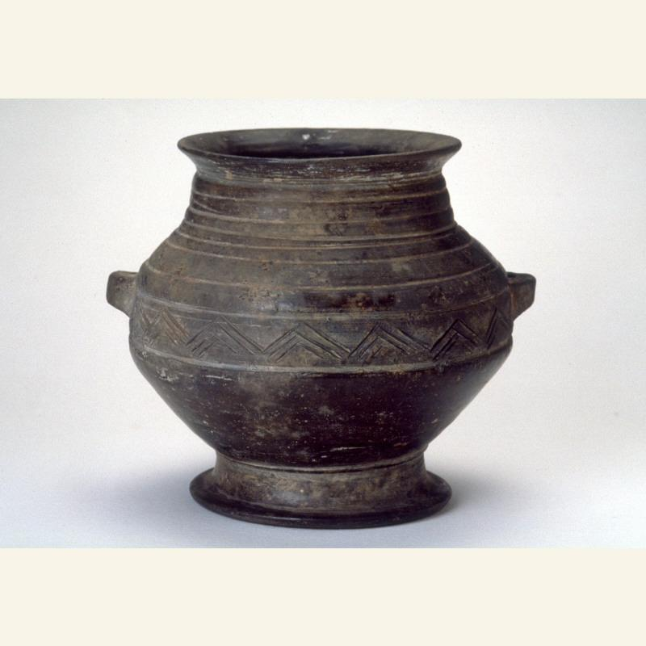
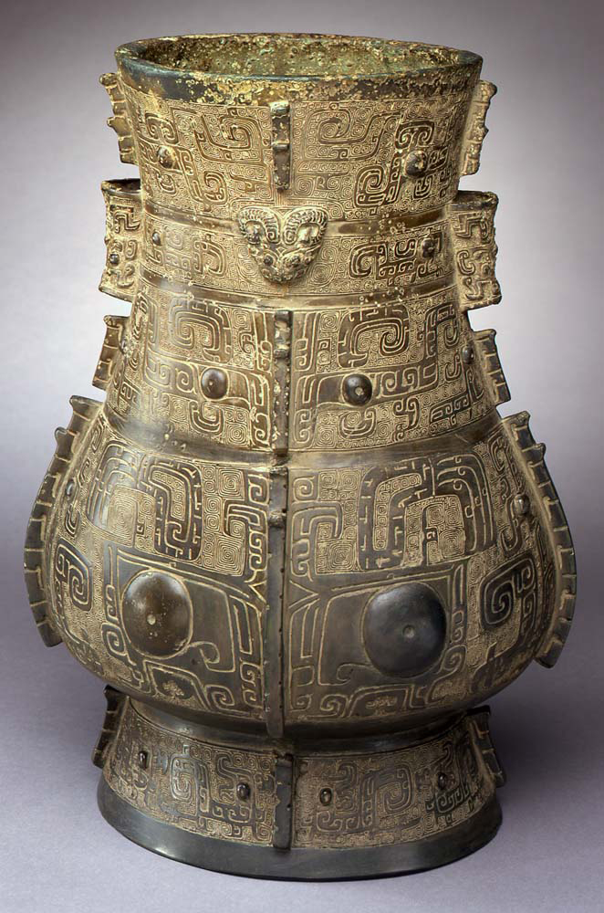
How are these vessels similar? How are they different?
Left:
Hu (wine storage) vessel
Shang approx.. 1200 – 1050 BCE
Gray low-fired ceramic
H 14 ¾ in x w 5 ½ in
Would you describe the decorations on the right ‘Hu’ as symmetrical or asymmetrical? Why?
Right:
Hu (wine storage vessel) Bronze Portland Art Museum
Shang approx. 1300 – 1100 BCE
16 1/2 in x 12 1/4 in diam
Bronze Hu for rituals to honor and request blessings from ancestors.
Ceramic Hu for everyday use
Notes:
Pottery is an art form that predates metalworking. Glazed vessels were used in households for storage and cooking. Ceramic vessels are found in a variety of shapes that were later cast in bronze. Advances in pottery and glazing allowed Shang artisans to create molds in which they could cast elaborately decorated bronze vessels. Right image:- “This magnificent hu illustrates the remarkable skill of the royal Shang dynasty bronze foundries. Shang ritual bronzes were made in ceramic piece molds, drawing on centuries of Chinese experience in kiln technology. The caster began by making a clay model of the vessel, carving the design into its surface. The model was packed in another layer of clay, which was allowed to harden and then cut away in sections and fired. (These outer sections bore the imprint of the surface design.) The inner clay core was then pared down evenly on all sides and placed inside the outer mold. Molten bronze was poured into the gap and allowed to cool. After some final sanding and polishing, the vessel was complete. The dark green patina is caused by centuries of exposure to soil and air. Shang ritual bronzes are decorated with majestic and witty zoomorphic motifs, with an emphasis on the eyes. On this hu, the widest band of decoration consists of a large taotie (composite animal) mask. Small dragons, looking backward, parade around the foot of the vessel, while the upper two registers seem to portray elephants (facing the center) and birds (facing the sides). The remaining band of decor, just above the large mask, can be read either as two mythological animals in profile or as a frontal mask. On second look, the play between frontal and profile views seems to be everywhere. These puzzling designs may suggest the role of the animals consumed in ritual sacrifice, as creatures undergoing a transformation from one state to another, from the mundane to the supernatural world.” [copied from PAM site]

Slide 8
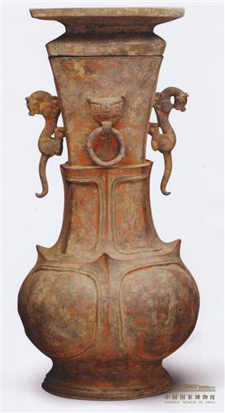
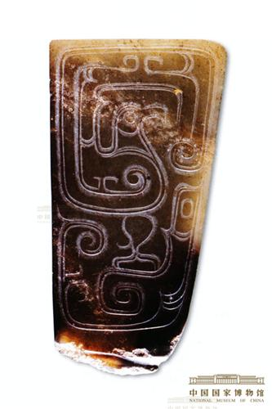
Zhou Dynasty 1045 – 256 BCE
What animals can you find?
Would you call these realistic or stylized?
What kind of lines can you find on these pieces?
Red-painted ceramic animal handle flask
Warring States（475-221 BCE)
Height 70 cm, Diameter at mouth 20 cm
Excavated in 1957 from Warring State tomb at Songyuancun, Changping District, Beijing
Jade axe handle with phoenix design
Mid Western Zhou (c. 10th century BCE)
H 7.2 cm, W 3.8 cm, Thickness 0.4 cm
Excavated in Puducun, Changanxian, Xian, Shaanxi Province
Notes:
Zhou (pronounced Jao) The Shang excelled in war, and the ruling classes built up great wealth. But in time these very strengths helped to bring the end of the dynasty. Fighting so many wars eventually weakened the military power of the Shang. Also the later Shang kings and nobles spent enormous amounts of money on Palaces, clothing and tombs mostly on the work of the underclasses. The final blow was the corruption of the final Shang king, who spent his time hunting instead of ruling. When a frontier stae call Zhou rose up they caught Shang rulers unaware and defeated them. Legend says the last Shang king ran from the battlefield, put on all his jewelry, and threw himself into the flames of a fire as the Zhou rebels stormed his capital city. The Zhou claimed to have a ‘Mandate from Heaven’, a divine right to rule China. Heaven controlled human destiny and if the King did not rule well, earthquakes and flood would appear showing he had lost the support of heaven and could be overthrown. The Zhou increased stability through a form of feudalism. The king owned all land but gave p
Red Painted vessel : In the Late Zhou/Warring States and Qin periods, it became the custom to bury the dead with pottery models of everyday objects that led to a growth in pottery manufacture. The red painted animal handle flask found near Beijing, is an imitation of a contemporary bronze ritual vessel that captures both the dignity of the bronze as well as its form and structure. 2nd piece The development and growth of the institution of wearing jade became representative of the Western Zhou period, alongside the use of jade in burials. In the Spring and Autumn and Warring States periods, wearing jade was symbol of rank and had become the main focus of jade development. Based on Confucianism as the ritual system, at this time jades were assigned an ethical quality and there was a tendency towards personalizing them. They were used as a symbol of the prevailing belief in the moral authority of the nobles.

Slide 9
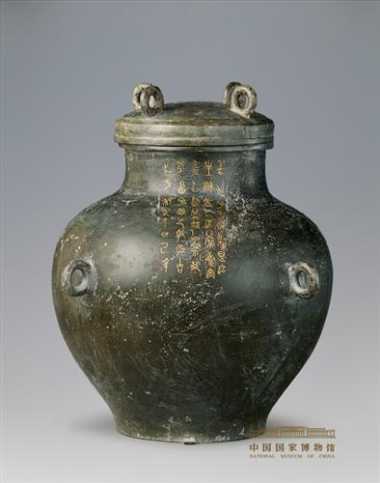
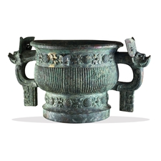
Luan Shu vessel (fou)
Zhou (Mid Spring and Autumn) (670–571 BCE)
Height 40.8 cm, Diameter at mouth 16.5 cm
Chinese Zhou ritual vessel (gui)
early Western Zhou dynasty, 11th century BCE
British Museum
Notes:
Fou vessels are divided into zunfou and yufou, wine vessels and water vessels. This is one of the former, a wine vessel, and is in two parts, the body and the lid. The convex lid bears four ring knobs. The lid knobs and handles have a design of angular clouds. The body is unadorned.
Left: -There is an inscription of 40 characters in five lines running from the neck to the shoulder. It records that this vessel was made for Luan Shu’s descendants to offer sacrifices to their forbears. The inscription is inlaid with gold, as is typically seen on weapons but usually with fewer characters than here, making this a very rare piece. The gold sparkles, the characters are elegant, neatly written, reflecting the level of bronze making in the Jin state during the Spring and Autumn period of the Zhou Dynasty. (Su Qiang) Vessel 3: -In 1050 BC, King Wu established the Zhou dynasty, having conquered the Shang dynasty (about 1500-1050 BC). Long inscriptions in bronze vessels tell of this conquest and subsequent events.
Such long inscriptions were cast only occasionally in bronzes during the Shang period, but this practice was greatly expanded by the Zhou. Inscriptions cast in bronzes served to communicate the political and social achievements of the vessels' owners. Today, they are vital historical documents.
Right: The inscription inside this imposing vessel tells that King Wu's brother, Kang Hou (Duke of Kang) and Mei Situ were given territory in Wei (in Henan province) in recognition of their contributions. The inscription relates a rebellion by remnants of the Shang, and its successful defeat by the Zhou, which helps us to date it.

Slide 10
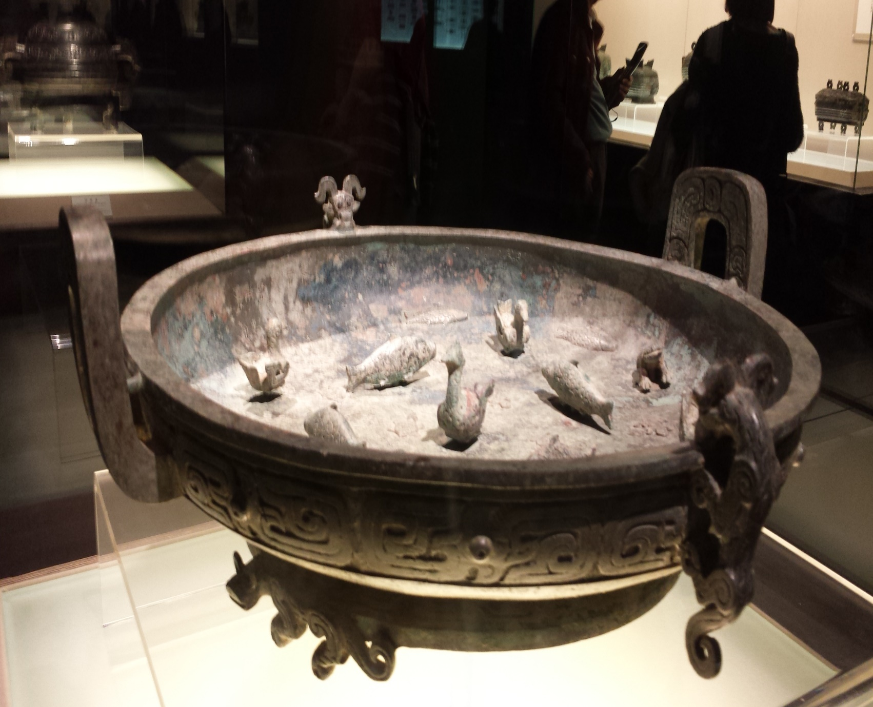
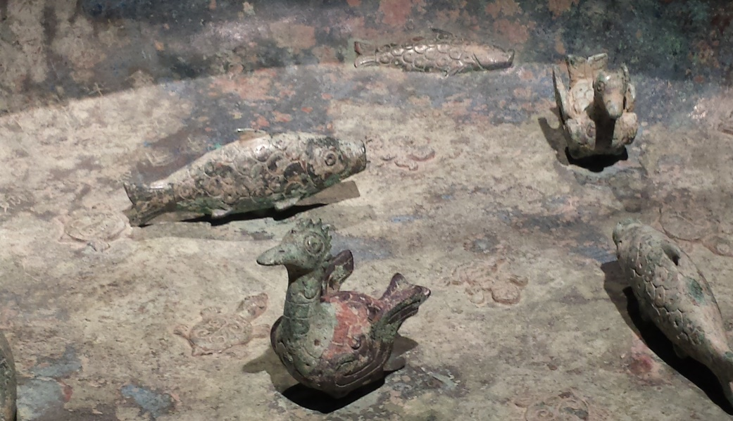
Detail of pot, Can you find the relief sculpture and 3D sculptures?
This Pan (water vessel) is a bowl used to catch water after ritual washing at sacrificial ceremonies and banquets during the Zhou. The inscription cast inside records this was commissioned as a gift from a husband to his wife.
Pan (water vessel), Mid Zhou (770 – early 7th C BCE)
Notes:
This Pan (water vessel) is a bowl used to catch water after ritual washing at sacrificial ceremonies and banquets during the Zhou. The inscription cast inside records this was commissioned as a gift from a husband to his wife.

Slide 11
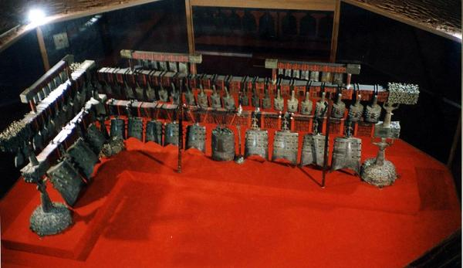
Bianzhong 編鐘 Chinese Bronze Bells
The Zhou Dynasty saw the height of popularity for Bianzhong. Each bell took great skill in the design and forging to create two tones 1/3 apart on the scale but by the Middle of the Han Dynasty the tradition and skill had been lost. Single or small sets of bell had been found from the Shang era, but one of the most important sets of Bianzhong discovered are a complete ceremonial set of 65 zhong bells, found in a near-perfect state of preservation during the excavation of the tomb of Marquis Yi, who died ca. 430 BCE. Yi was ruler of Zeng, one of the Warring States during the Zhou Dynasty.
http://www.youtube.com/watch?feature=player_detailpage&v=zhcCSeRj2PU
Notes:
Bianzhong (simplified Chinese: 编钟; traditional Chinese: 編鐘; pinyin: biān zhōng, pronounced [pi̯ɛ́n t͡ʂʊ́ŋ]) is an ancient Chinese musical instrument consisting of a set of bronze bells, played melodically. These sets of chime bells were used as polyphonic musical instruments and some of these bells have been dated at between 2,000 to 3,600 years old. They were hung in a wooden frame and struck with a mallet, and were an important instrument in China's ritual and court music going back to ancient times. They're shaped a lot like our cow-bells, but these had no clappers. They were struck.
The importance of that discovery grows when we realize that it took the West a thousand years to develop the cathedral bell, and we didn't have it until the middle ages. Bells are very hard to make, yet China had these remarkably sophisticated Zhong bells as early as 3000 plus years ago. The bells produce a rich tone, they take far less bronze to get it than a cathedral bell, and then they deliver two sounds for the cost of one.

Slide 12
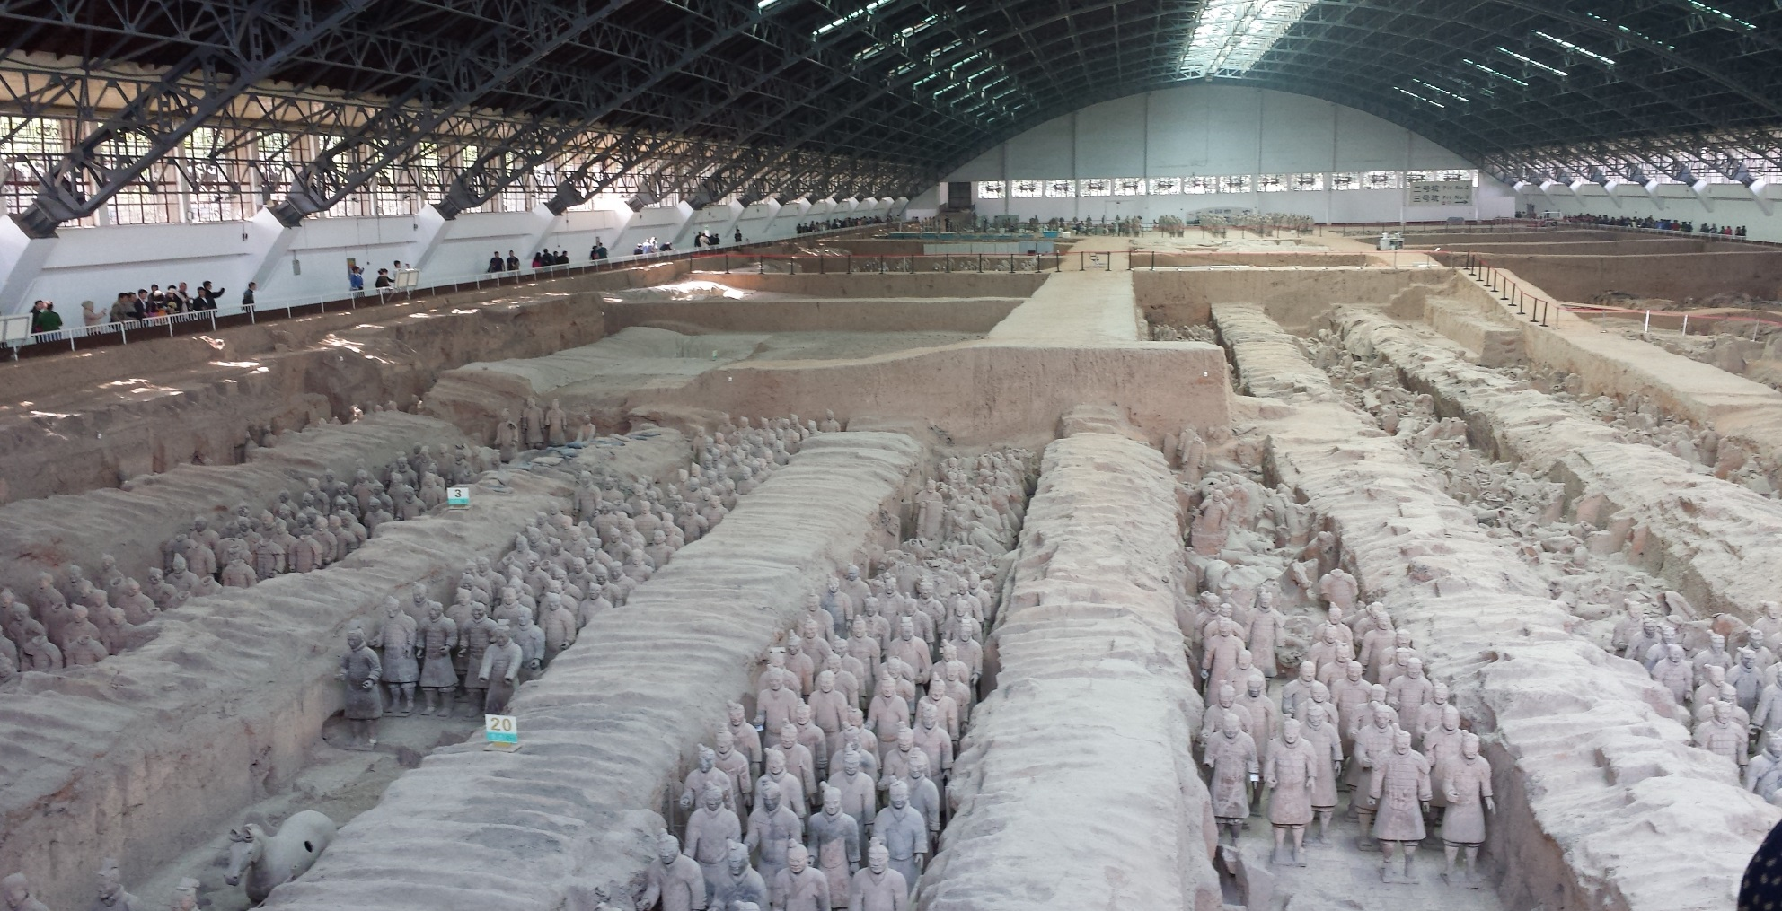
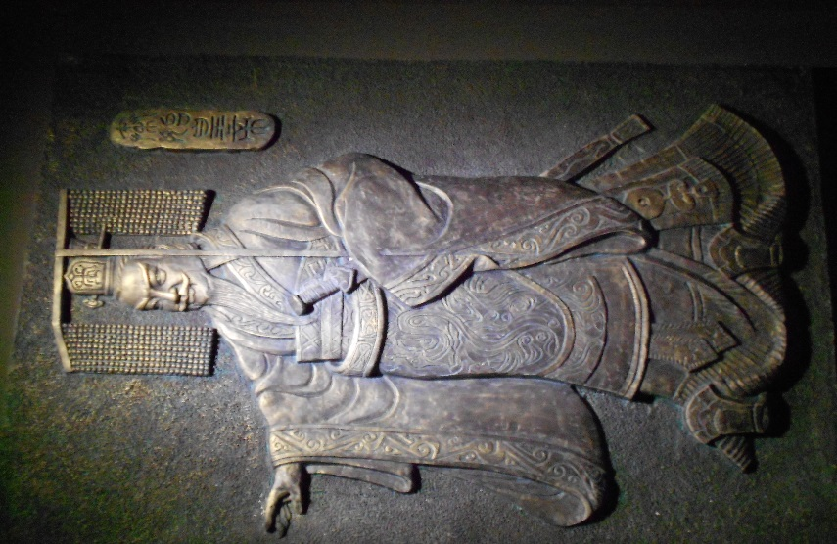
Qin Dynasty (221 – 206 BCE) Terracotta Warriors
Qin Shi Huang
The First Emperor
Terracotta warriors from Pit 2 after refurbishment over 8,000 warriors have been found with many more waiting to be uncovered.
Notes:
Prince Zheng of the Qin State came to power at age 13 through a combination of military might, spies, bribery and alliances he was able to conquer the rival ‘warring states’ and create a unified China larger than any previous dynasty. He thought his accomplishments so great he named himself Qin Shi Huang first Emperor of all China. Even before this time he began planning for a great tomb to include warriors, weapons, entertainers and all he would need to continue his great reign in the afterlife. Over 700,000 peasants were conscripted to build his tombs, palaces and temples and many of these workers died during this time. Emperor Qin also unified China’s laws, writing and measuring systems and languages, connected and extended the North walls to be the Great Wall that we know today. This allowed for unprecedented growth and cohesion for the country and even today though he is acknowledged as a harsh leader which especially the peasant class suffered under, he is also well respected for his amazing accomplishments in such a short time.

Slide 13
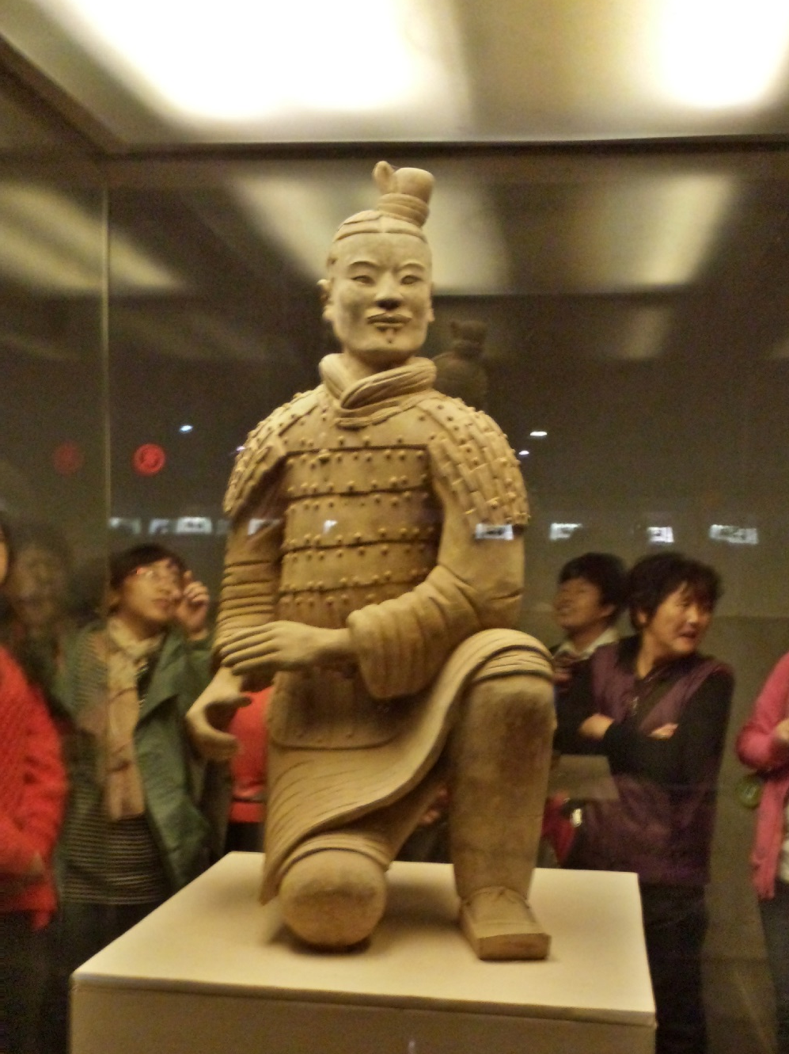
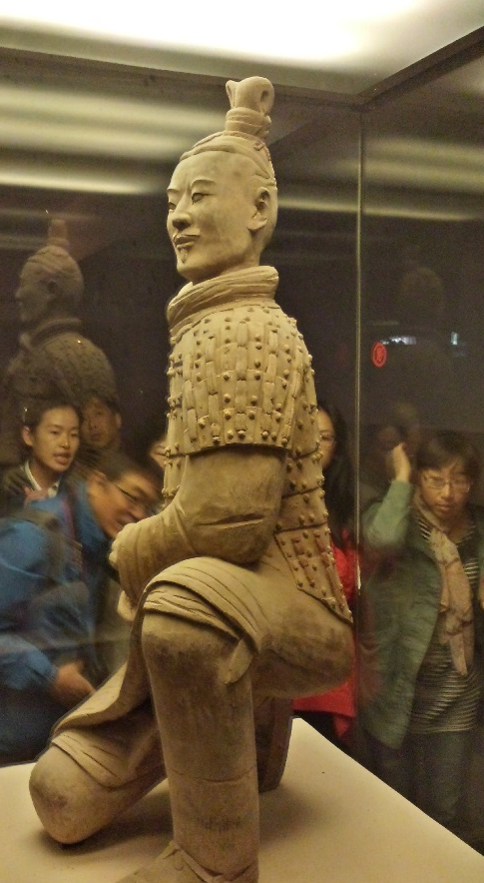
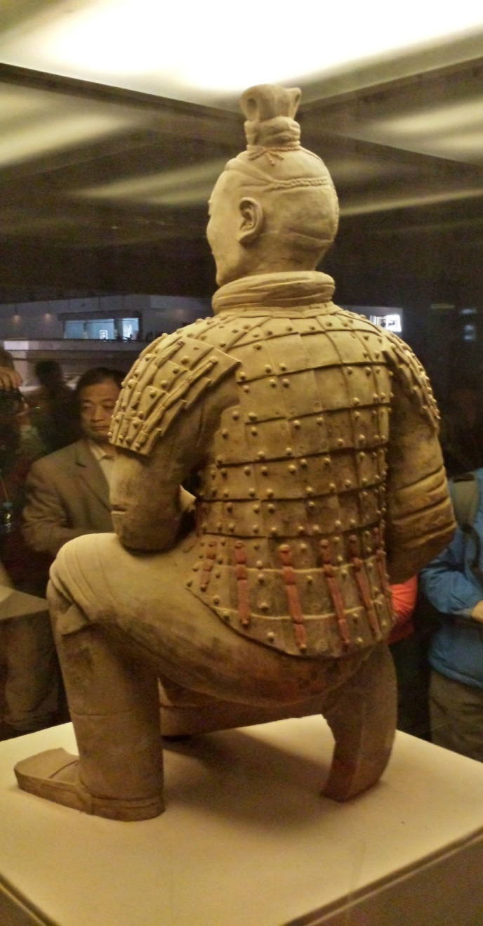
Kneeling Archer only warrior to be found fully in tact.
Notice detail on riveted armor, archers hair in one knot on left side of head, how do you think this was made?
Notice red paint on armor, originally the warriors uniforms were painted blue and red, but once unearthed the paint quickly deteriorated.
Notes:
In 1974 three farmers while digging for a well came across a terracotta head and many unusual ceramic pieces. When government archaeologist came they discovered a vast burial pit filled with broken life-size terracotta warriors. The warriors were originally brightly painted blue and red, but after being exposed to the air they quickly deteriorated. Still today they have been unable to find a way to prevent this color loss and deterioration , so many pits at this vast tomb site are being left buried until they can find a way to preserve them. This Archer is the only warrior to be found fully intact. The detail on his armor are amazing, you can still see a small bit of the original color on the back of the warrior.

Slide 14
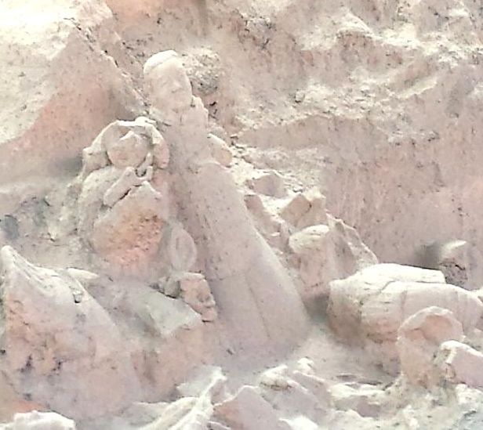
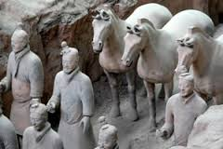
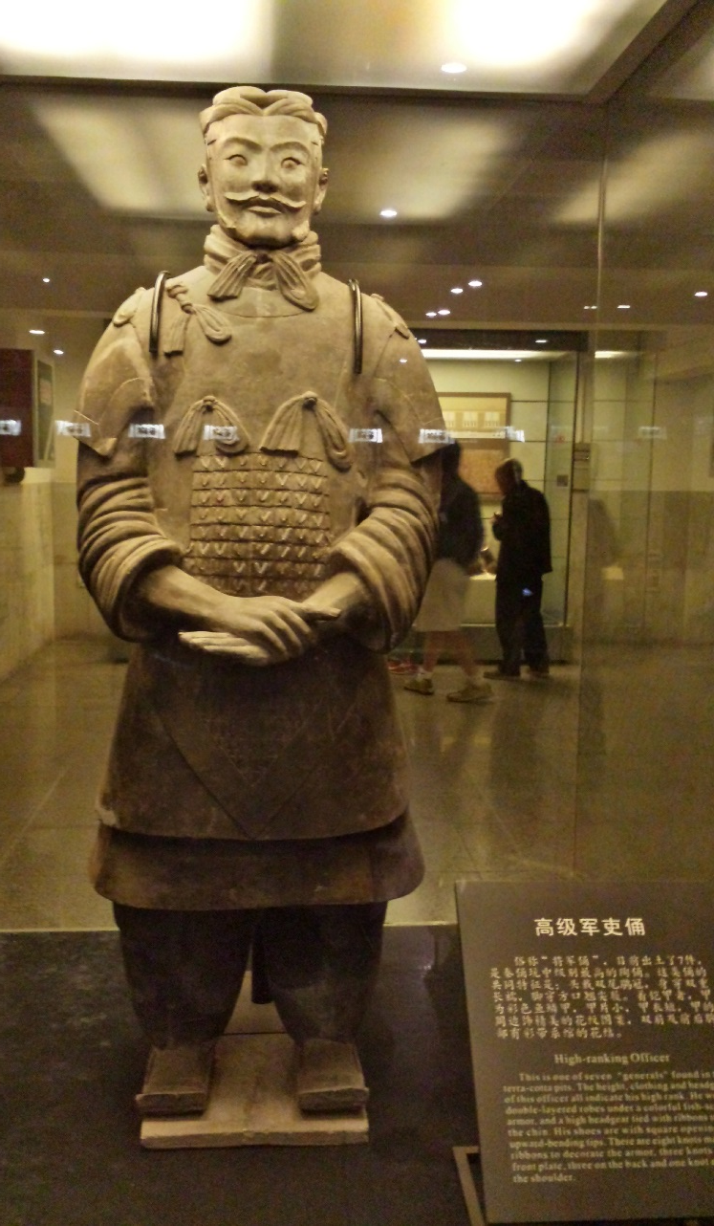
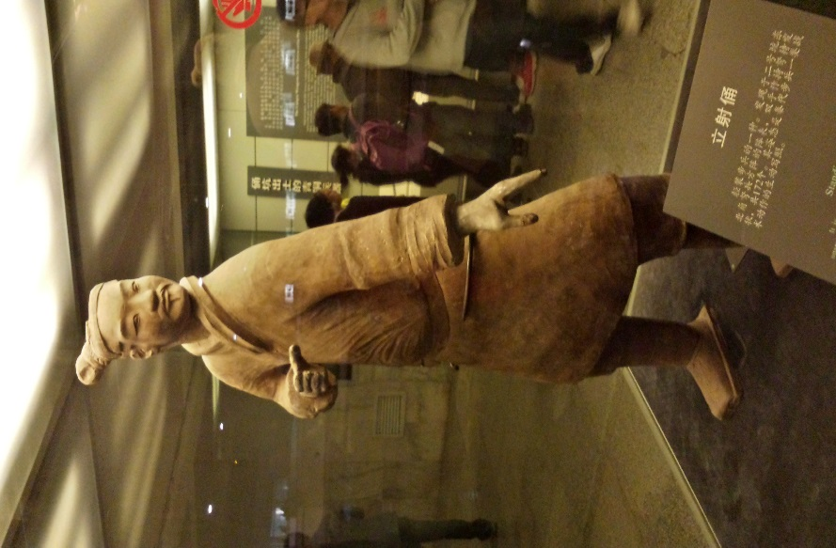
Terracottas as unearthed.
Above - Cavalry soldiers and their horses in pit
Right – Standing infantry man denoted by hair knot on right side of head.
Have you noticed that all faces are different? Each warrior was based on real soldiers and are all unique.
High ranking officer, this is shown by hair in two knots and many knots on uniform. Also the officers were better fed (bigger tummies) than other troops.

Slide 15
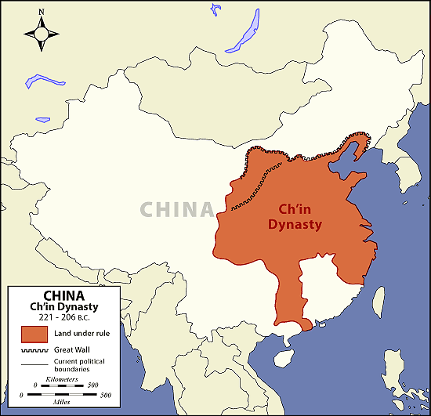
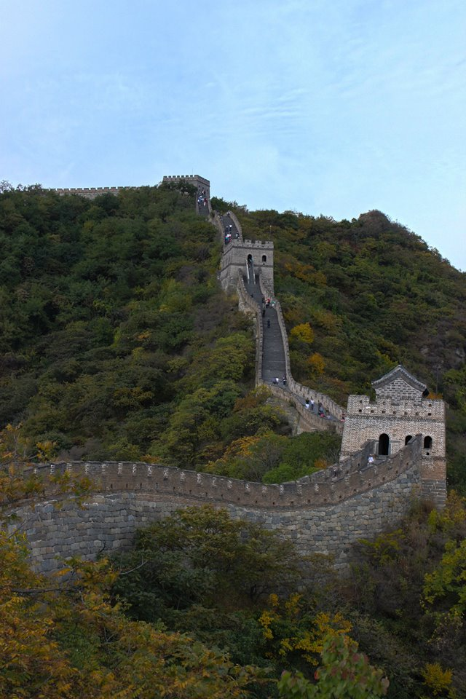
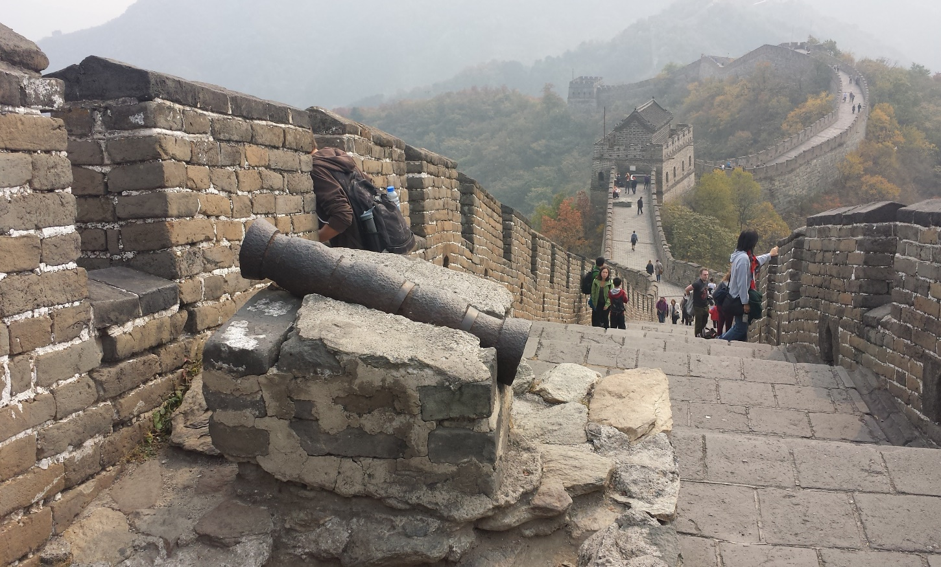
Great Wall of China
Notes:
To the Chinese, the Great Wall is known as “Wan Li Chang Cheng” (万里长城 ), or literally, “Long Wall of Ten Thousand Li” (“li” being a measure of distance about 500m or about a third of a mile). But of course, that’s not the actual length of the wall, but just an ancient way of “a majorly long’ wall.” Originally built mainly of stone and earth by connecting and reinforcing shorter previous walls, the Qin Emperor used more than 500,000 peasants and slaves to build the wall. Many of them died doing this work so it was also referred to as the longest burial tomb in the world. These images and most of what we have today came from a 100 year rebuild during the Ming Dynasty (1368-1644 CE)

Slide 16
How many Guard stations can you count along the wall? Why do you think they are spaced this way?
The space between Guard stations was the distance two arrows could fly.
Notes:
This section of wall is approximately 90 minutes outside Beijing. The characters on the hillside below the wall is a tribute to Chairman Mao the leader of the Cultural Revolution. Fast forward to the 15th and 16th centuries. The most impressive “modern” sections of the Great Wall were all constructed during the Ming Dynasty (1388-1644 CE). The insular Ming emperors didn’t just fortify parts of the wall…we’re talking about over a 100-year effort to completely rebuild and reinforce the wall using modern brick and mortar construction (and you thought your kitchen renovation project was a never-ending money pit).

Slide 17
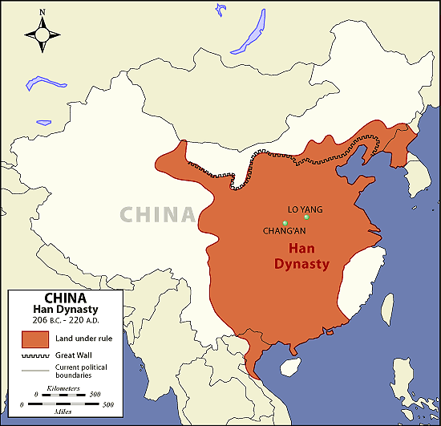
Han Dynasty 206 BCE – 220 CE
Notes:
Writing materials
Typical ancient Chinese writing materials were bronzewares and animal bones. By the beginning of the Han Dynasty, the chief writing materials were clay tablets, silk cloth, and rolled scrolls made from bamboo strips sewn together with hempen string; these were passed through drilled holes and secured with clay stamps.^{[222]}
The oldest known Chinese piece of hard, hempen wrapping paper dates to the 2nd century BC. The standard papermaking process was invented by Cai Lun (50–121 AD) in 105 AD.^{[223]} The oldest known surviving piece of paper with writing on it was found in the ruins of a Han watchtower that had been abandoned in 110 AD, in Inner Mongolia.^{[224]}

Slide 18
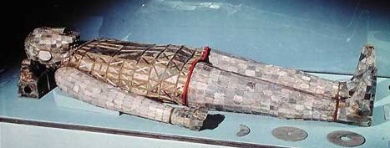
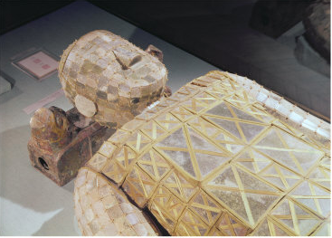
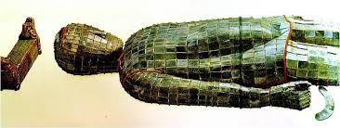
Above is Princess Dou Wan’s jade burial suit, below is husband Prince Liu Sheng
What Shape repeats throughout each suit?
Rectangles
Are these balanced forms?
Notes:
Although their coffins had collapsed, Liu Sheng and Dou Wan were each found in a well-preserved jade suit. Liu Sheng's was made of 2498 pieces of jade, sewn together with two and a half pounds of gold wire (Dou Wan's was smaller). Each suit consists of 12 sections: face, head, front, and back parts of tunic, arms, gloves, leggings, and feet. It has been estimated that a suit such as Liu Sheng's would have taken ten years to fashion. Along with the jade suits, Liu Sheng and Dou Wan each had a gilt bronze headrest inlaid with jade and held jade crescents in their hands.
Archaeologists had known of the existence of jade burial suits from texts, but the two suits found at Mancheng are the earliest and most complete examples ever discovered. During the Han, jade funerary suits were used exclusively for the highest ranking nobles and were sewn with gold, silver, or bronze wire according to rank. The practice was discontinued after the Han.
What beliefs about the soul and the afterlife are reflected in the practice of wearing jade burial suits?

Slide 19
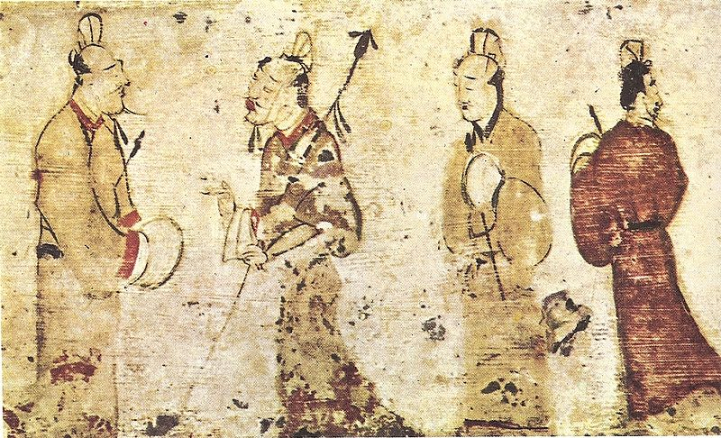
What does this tell us about life in China 2000 years ago? There is no background on this painting why would that be?
Notes:
Anonymous Chinese artist Description : Two gentlemen engrossed in conversation while two others look on, a Chinese painting on a ceramic tile from a tomb near Luoyang, Henan province, dated to the Eastern Han Dynasty (25–220 AD) Current location Museum of Fine Arts, Boston
Funerary banner from the tomb of Lady Dai (Xin Zhui), Mawangdui, Hunan province, ink and colours on silk, c. 168 bc, Western Han dynasty; in the Hunan Provincial Museum, Changsha, China.

Slide 20
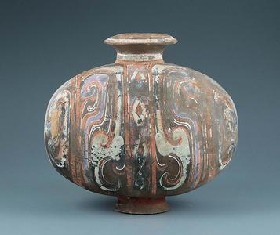
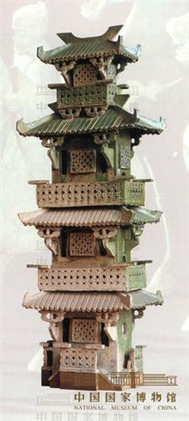
Green glazed house
Eastern Han（25-220 CE）
Height 152.3 cm
Excavated in 1956 from Gaotangxian, Liaocheng, Shandong Province
Han Dynasty Cocoon Vase - Western Han dynasty, late 3rd-1st century BCE. It is made from a grey earthenware,
11 1/2 x 13 1/8 x 9 1/4 in. (29.2 x 33.3 x 23.5 cm)
Notes:
The Han began to use colorful low-fire glazes for decorations. The detail on the house is beautiful and intricate and stands close to 5ft tall. The Han also saw beautiful green glazes being used which eventually led to the famous Chinese celadon green earthenware and porcelain
Jar on left Kimbell Museum Fort Worth TX

Slide 21
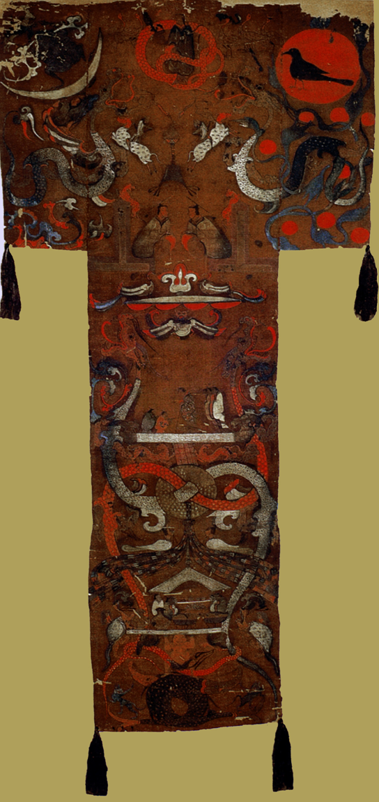
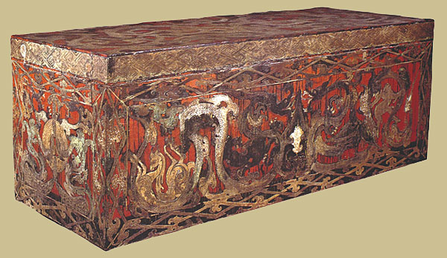
Funerary banner from the tomb of Lady Dai - ink and colours on silk, c. 168 bc,
Western Han
Coffin of the third layer with Painted Design on Vermilion Lacquer Coating, Unearthed from Tomb No.1. Length 230cm width 92cm height 89cm.

Slide 22
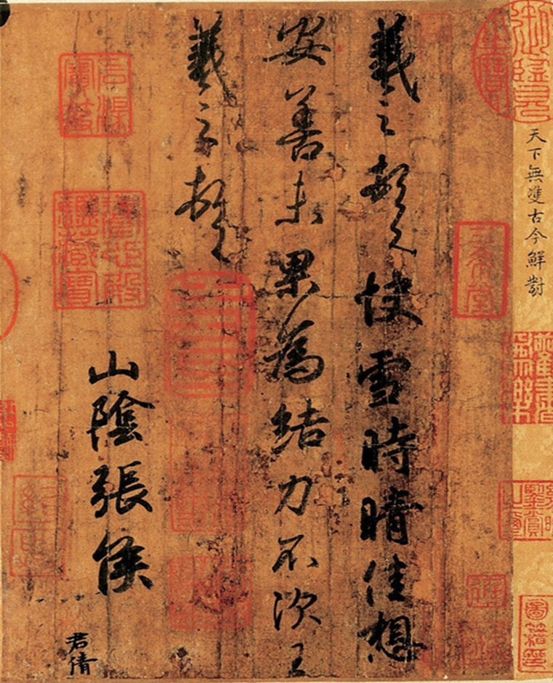
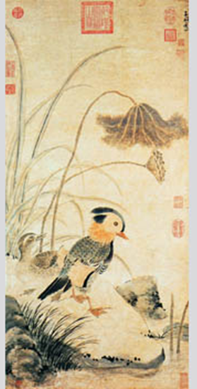
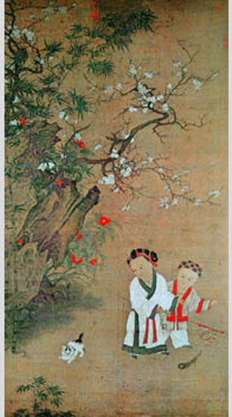
Chinese Calligraphy
& Brush Painting
Left: Zhang Zhong, Yuan Dynasty
Ink and color on paper
Right: Song Dynasty
Ink and color on silk
195.6*106.7cm
Timely Clearing After Snowfall (快雪時晴帖)Wang Xizhi (王羲之, ca. 303-361),
Jin Dynasty (265-420 CE) Album leaf, Running script, ink on paper, 23 x 14.8 cm, National Palace Museum, Taipei The artist sends a timely greetings after a snow fall.
Notes:
Left Zhang Zhong, Yuan Dynasty
Ink and color on paper
96.4*46cm
Zhang Zhong specialized in landscape and flower-and-bird painting. This painting depicts the happy conjugal life of a pair of mandarin ducks on a lotus pond, gilt by the setting autumn sun. The mandarin duck is noted for its fidelity to its spouse and marries only once in its life. It is therefore considered a symbol of love and family life. "He", meaning lotus, and "he" meaning harmony are homophones in Chinese. The artist puts a pair of mandarin ducks in a lotus pond to wish the recipient of the painting a harmonious, happy family life. In a development of the Song tradition of drawing flowers and birds from life, the artist uses a variety of brushwork idioms to convey a strong sense of texture, but never loses the general orientation of vivid portrayal of objects.
Left: Song Dynasty Ink and color on silk
195.6*106.7cm
In a corner of a garden on a winter day the bamboos are still green and the white plum blossoms are in full bloom. Bright red blossoms break out on an early blooming camellia. Sister and brother are absorbed in playing with a kitten. The sister teases the cat with a colorful flag while protecting the brother with her other hand. The kitten pounces and romps. The painting exudes harmony and happiness. The hair of the two children is quaintly done and their dark eyes sparkle. This vivid picture was probably commissioned as a portrait of the children.

Slide 23
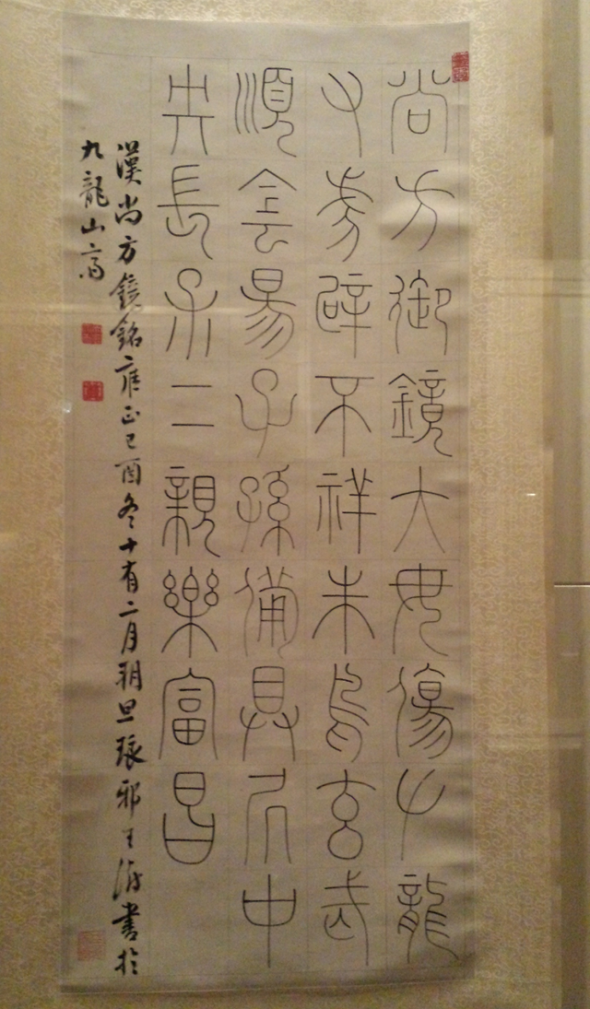
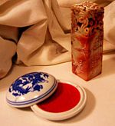
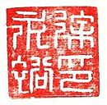
Seal script the earliest form of Chinese pictographs or characters. It was also used to create name seals or chops to mark ownership, artist or place.
Inscription on Han Bronze Mirror
By Wang Shu
Seal Script Qing Dynasty 1729 CE
Notes:
Much of the brushwork appears round and blunt, the dots and hooked strokes not revealing the tip of the brush. The characters are even and balanced, revealing a straightforward elegance and introverted harmony. The Qianlong Emperor (reigned 1735-1796) in the Qing dynasty especially prized this work, praising it as "The one and only; a masterpiece for all time (天下無雙，古今鮮對).
“Modern” Chinese writing is thought to have begun with the Han. During this period clerical script which superseded seal script as the normal script for general documents went through a radical reform. By fabricating character elements, or radicals, and by reorganizing characters with the newly developed elements, the last pictographic vestige in small seal script was eliminated - the design of Chinese written language was finalized. A overwhelming majority of clerical characters have continued into modern times. To this day, the Chinese still refer to their characters as “han zi”, or Han characters, an echo of remote glory.

Slide 24
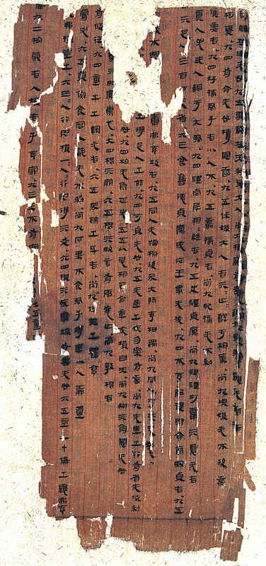
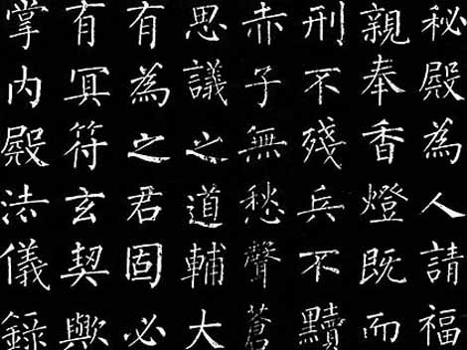
Relics from Mawangdui Tombs Han Dynasty
(168 BCE)
Book of Changes
(Zhou Yi )
Above: Clerical or Regular script from Stele
1st Century BCE
Notes:
Regular script is also known as “Clerical Script" and “True/Standard Script". "Regular" means model, namely, this type of script can be deemed as a model or standard script. There was a saying about calligraphy learning in ancient times, "Regular script is a must when learning calligraphy". This is because regular script is easy to write due to its square form and structure as well as straight strokes. Accordingly, since the date it was created, regular script has served as an official script in China over thousands of years.
The perfection of clerical script. Later Han period saw many stone steles. Stele was originally a monolith served as a sundial in front of Zhou's ancestral temples. Han adopted Zhou's patriarchal clan system, and the use of stele was expanded to record events, declare official merits, perpetuate the memory of individuals in their epitaph tablets, and preserve the canons of Confucian and Taoist texts. These steles were inscribed in clerical script. Finalized clerical script was formal in composition, regular in stroke placement, and dignified in expression. In next five hundred years, clerical script remained the official script through successive dynasties.
The creator and exact period in which he lived are not clear. However, in the opinion of most of calligraphists in the past generations, the originator is Wang Cizhong in the late Han Dynasty.
Regular script acts as an evolving mainstream of standard font and other fonts of Chinese characters. From this set writing form emerged two additional Chinese calligraphy styles:-cursive script and running script (auxiliary fonts).
Right: The earliest systematic calligraphy form in China, seal script is characterized by flat elongated characters worked out in rounded strokes. The pre-Qin characters are called "Big Seal Script" and the characters after Qin's unification are called "Small Seal Script". The latter abolished the use of the large number of regional variations of characters, further unifying, simplifying and standardizing the Chinese language. It was the first massive systematic codification of ancient Chinese characters in Chinese history. Small Seal Script, after being unified, took on more symbolic features and exerted profound influences on the standardizations of language in later generations.
As an art of calligraphy, seal script has been until today frequently used in artists' seals. On the other hand, its rich visual elements have endowed new life to seal script, the earliest systematic calligraphy form in China, in the fields of modern advertising, and icon and pattern designing.
Zhou Yi is a book on divination. This is one of the earliest copies of Zhou Yi still in existence; it is quite different from the current editions in the arrangement of the trigrams. Written in the formalized Han clerical script, it might be a copy transcribed in the early years of the reign of the Han Emperor Wendi.

Slide 25
Ten Letters by Ahao Mengfu (1254-1322) Yuan Dynasty Artist was adept at painting and calligraphy
Semi-cursive Script or “Running Script”
Notes:
The Semi-cursive Script (also called "Running Script") is a calligraphy style with free movements, between the Regular Script and the Cursive Script. It was created in the late Eastern Han Dynasty to make up for the slow-speed writing of the Regular Script and the difficulty in reading the Cursive Script.
The most striking features of the Semi-cursive Script are stroke connection and omission, the inclusion of few or no cursive characters and the retaining of easily-readable structures of the Regular Script. Thus, the Semi-cursive Script is a practical style that can be quickly written and read with ease. The Semi-cursive Script is romantic and aesthetic and characterized by smoothness with no scribbles and regularity with no restriction.

Slide 26
Cursive Script
Zhang Zhi (c. 192 CE) February Eighth
What are red marks on scroll called?
Ode to Peony (excerpt) by Anu Yumming (1466-1526) famous for his cursive script.
Chop or Seal
Notes:
Cursive script emerged in the early years of the Han dynasty as a result of its convenience in writing. Its basic characteristics can be summed up as: an impression of vigorous and unrestrained spirit is revealed in the rhythmic and fast movement of brushes.

Slide 27
Nymph of the Luo River (洛神賦) by Gu Kaizhi (c. 400 CE)
He used diagonal and wavy lines to show waves by the boat or banners /clothing waving in the air.
How does that artist show movement?
Notes:
Nymph of the Luo River is a painting by Gu illustrates a poem written by Cao Zhi (192-232). It survives in three copies dating to the Song Dynasty.^{[3]} One copy is now held in the Palace Museum in Beijing,^{[3]} and another one is now at the Freer Gallery in Washington, D.C.^{[3]} The third was brought to Manchuria by the last emperor Pu Yi (1906–1967) while he was the puppet emperor of Manchukuo under Japanese rule. When the Japanese surrendered in 1945 the painting disappeared. After ten years the Liaoning Province Museum recovered it.[3] This is a copy from the Song Dynasty (960 -1279 CE) it is Ink on silk and measures 27 x 572 cm This painting is said to be Gu Kaizhi's signature work, drawing its subject matter from a prose-poem(fu) by the poet and prince Cao Zhi of the Three Kingdoms period dedicated to his deceased love whom he met by the Luo River in his dream. In the painting the prince and his love never seem able to touch each other, resigned to longing for and adoring the other from afar. The figures, objects, rocks and mountains, trees and river are depicted with fine and forceful brushstrokes, with no texturing because the technique of creating three-dimensionality with light-ink texturing strokes had not yet been invented. In order to put the spotlight on the figures, the mountains and trees in the foreground are made disproportionately small in relation to the fogures. After colors are added, some three-dimensionality comes through.

Slide 28
Court ladies adorning their hair with flowers(detail)
Tang Dynasty (618-906 CE)
Zhou Fang
Ink and color on silk
What Differences do you notice in clothing and hair styles between the two paintings? What is the same?
Admonitions of the Instructress to the Court Ladies (女史箴圖)
Attributed to Gu Kahzi (345-406),
Handscroll, ink and colors on silk
Notes:
Zhou Fang specialized in figure painting, and was counted by Mi Fu in his "History of Painting" as one of the Four Masters of Figure Painting of the Jin and Tang periods, on a par with Gu Kaizhi, Lu Tanwei and Wu Daozi. This painting depicts five court ladies and one maid servant, some looking at flowers, some strolling, and some playing with a crane or a dog, with the maid servant waiting on them holding a long-handled fan. Feminine beauty in the Tang dynasty consists in plumpness, painting eyebrows into butterfly wings, adorning one's high-pile hairdo with peony or lotus flowers. Trims on their dresses are sheer as cicada wings, mainly in red, ocher or white, in a reflection of the esthetic taste and the state of the textile industry of the time.
Admonitions of the Instructress to the Court Ladies (女史箴圖)
Attributed to Gu Kaizhi (顧愷之, ca.345-406), Jin Dynasty (265-420)
Handscroll, ink and colors on silk, 24.4 x 343.8 cm, The British Museum, London
This painting illustrates a political parody written by Zhang Hua (張華, ca.232-300). The parody takes a moralizing tone, attacking the excessive behavior of an empress. The protagonist is the court instructress who guides the ladies of the imperial harem on correct behavior. In total, nine scenes were depicted on this scroll, but it is now incomplete; the first two scenes are missing, as well as the text to the first scene.
This painting has been executed in a fine linear style that is typical of fourth-century figure painting. Similar pictorial motifs have been discovered in contemporary tombs. Texts describe Gu Kaizhi as having painted in this manner. The inscriptions and seals on this scroll date back to the eighth century, when this copy of Gu Kaizhi's original was probably painted.
Before its arrival at the British Museum in 1903, the scroll passed through many hands. The history of the painting can be ascertained through the seals and inscriptions, beginning with the eighth-century seal of the Hongwen Guan, a division of the Hanlin Academy.
The painting was subsequently in the collections of well-known connoisseurs who added their own seals and inscriptions, before ending up in the imperial collection during the reign of the Qianlong emperor (r.1735-96). In 1860, during the Second Opium War, the painting was looted by British troops from the Old Summer Palace and eventually came to the collection of the British Museum.

Slide 29
P
o
e
t
On
A
Mo
u
n
t
a
i
n
T
o
p
Notes:
Poet on a Mountaintop (杖藜遠眺) Shen Zhou (沈周, 1427-1509), Ming Dynasty (1368-1644) Album leaf, ink on paper, 38.7 x 60.3 cm, The Nelson-Atkins Museum of Art, Kansas City, Missouri Shen Zhou exemplified literati painting - his blending of poetry and painting, the arts of words and images. Many of Shen Zhou's paintings include poems of his own - many also include poems composed by friends. The painting above is one of Shen Zhou's most famous. The scholar alone in nature seems to be looking out not over a chasm of rocks and clouds, but directly at the poem that Shen Zhou has placed before him. The poem reads as follows: White clouds sash-like wrap mountain waists, The rock terrace flies in space distant, a narrow path. Leaning on a bramble staff far and free I gaze, To the warble of valley brook I will reply, whistling. (Translation from Indiana University.)

Slide 30
Hands-On – Chinese Brush Painting & Calligraphy
Ink Bamboo with Date and Chop
http://www.youtube.com/watch?v=v527vJObd64
Notes:
Left: Ke Jiusi-Twin Bamboo painted during the Yuan Dynasty

Slide 33
Figurines of Musicians. Unearthed from Tomb No.1
Figurines of maids with Painted Design. Unearthed from Tombs No.1 and No.3 Tomb of Lady Dai

Slide 37
Notes:
Ke Jiusi-Twin Bamboo painted during the Yuan Dynasty

