Slide 1
Notes:
Template – Copy onto Kraft (tan) paper and cut in half

Slide 2
Translate Your Name to Hieroglyphics
Name: ____________________________ Teacher/Per: _________
1) Refer to the handout and break your name into “letter sounds”. Some letters may have their own letter sounds, others may combine to form one letter sound, and some won’t have a sound at all!
Example: HEATHER (7 letters) = H E TH R (4 letter sounds)
Find the hieroglyphs that match each letter sound and sketch them here. Note: There may be more than one symbol for a letter sound! Sound it out and choose the symbol that matches best. Be sure to label each symbol with the matching letter sound.
Example
( R )
Translate Your Name to Hieroglyphics
Name: ____________________________ Teacher/Per: _________
1) Refer to the handout and break your name into “letter sounds”. Some letters may have their own letter sounds, others may combine to form one letter sound, and some won’t have a sound at all!
Example: HEATHER (7 letters) = H E TH R (4 letter sounds)
Find the hieroglyphs that match each letter sound and sketch them here. Note: There may be more than one symbol for a letter sound! Sound it out and choose the symbol that matches best. Be sure to label each symbol with the matching letter sound.
Example
( R )

Slide 5
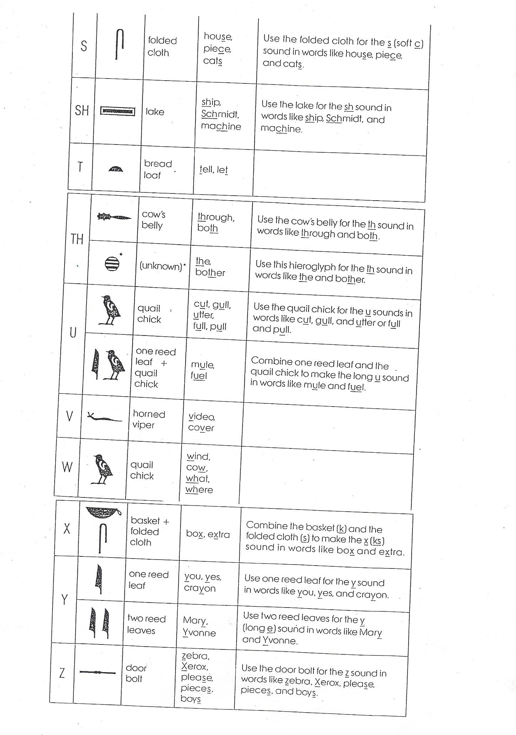

Slide 6
Samples for Egypt Project
Egyptian
Gods
TOTH
God of Knowledge
ANUBIS APIS
God of the Underworld,
embalming and funerals
God of strength
and fertility
Egyptian
Goddesses
BASTET
NEITH
SESHAT
Goddess of cats, protection, warfare,
joy, dance, music, and love
Goddess of hunting, war,
weaving and wisdom
Goddess of writing
and wisdom
Source For Top 3 Images (Gods):
http://www.artyfactory.com/egyptian_art/egyptian_gods/ancient-egyptian-gods.htm
Source For Bottom 3 Images (Goddesses):
http://www.supercoloring.com/coloring-pages Artist: Jeff Dahl
Creative Commons License Attribution-Share Alike 4.0 Images cropped, upper body only

Slide 7
Samples for Egypt Project
“King” or “Pharaoh” was the Ancient Egyptian title regardless of gender.
There were male and female Pharaohs in Ancient Egypt.
Source For All Crown Images: http://www.artyfactory.com/egyptian_art/egyptian_gods/ancient-egyptian-gods.htm

Slide 8
