Slide 1
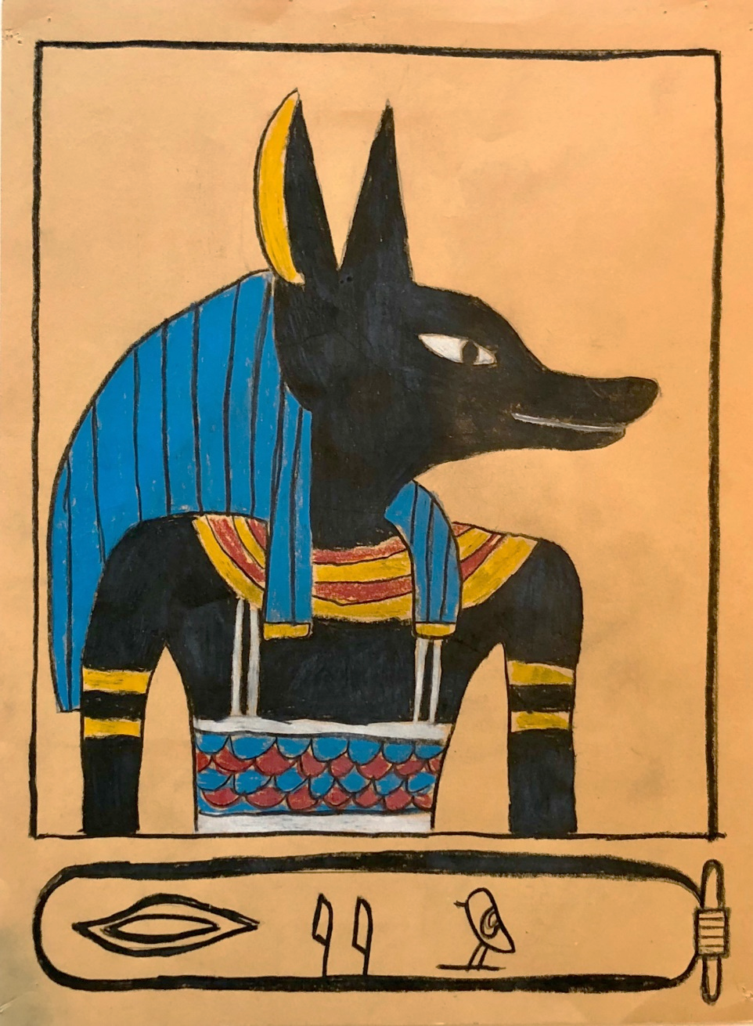
Art of Ancient Egypt: Hands-on Project
Portrait of God or Royal
Canon (Rules)
Cartouche & Hieroglyphs
Notes:
Tomorrow we are going to draw like an Ancient Egyptian!
Portrait inspired by an Egyptian God or Royal
Follow the rules for drawing gods and important people
Students add their own name to the cartouche.
Today we are going to get a head-start on the project, by translating your name into hieroglyphs.

Slide 2
H E A T H E R
Translating Your Name Into Hieroglyphs
Your Name: _______________________________________
Refer to the handout and break your name into “letter sounds”.
Some letters may have their own letter sounds, others may combine to form one letter sound, and some won’t have a sound at all!
7 Letters
H E TH R
4 Letter Sounds
Find the hieroglyphs that match each letter sound and sketch them here.
Note: There may be more than one symbol for a letter sound! Sound it out and choose the symbol that matches best. Be sure to label each symbol with the matching letter sound.
Notes:
Instructions for 2109: Complete hieroglyph translation on Day 1, after presentation.
NOTE: Explain process for translating their name BEFORE passing out the worksheets and handouts
Today you will translate your name into hieroglyphs, then tomorrow you will incorporate them into your art project.
All instructions are on the worksheet that we will pass out in a minute, but I’m going to quickly review them first.
You will start by writing you first name, then breaking your name out into letter sounds. Using the name “Heather” as an example, notice that some letters may have their own letter sounds (H, E & R), others may combine to form one letter sound (TH), and some have no sound (A).
<CLICK> While the name Heather has 7 letters, it only has 4 letter sounds.

Slide 3
Notes:
Next, find the symbols that match each letter sound. Note that there may be more than one symbol for a letter sound! Sound it out and choose the symbol that matches best. Example: Two sounds and two symbols for “E”.

Slide 4
H E A T H E R
Translating Your Name Into Hieroglyphs
Your Name: _______________________________________
Refer to the handout and break your name into “letter sounds”.
Some letters may have their own letter sounds, others may combine to form one letter sound, and some won’t have a sound at all!
7 Letters
H E TH R
4 Letter Sounds
Find the hieroglyphs that match each letter sound and sketch them here.
Note: There may be more than one symbol for a letter sound! Sound it out and choose the symbol that matches best. Be sure to label each symbol with the matching letter sound.
H E TH R
Notes:
Sketch the hieroglyphs for each letter sound and label them.
PRESENTER:
Pass out the worksheets and handouts
Leave this screen up while kids complete their worksheets
Collect the students’ worksheets at the end of class – they will get them back tomorrow.

Slide 5
Starting Materials
Cardstock
Frame for portrait
Cartouche
Hieroglyph Worksheet
Pencil & Eraser
Sign the back!
Your name
Teacher’s name
Class period
Notes:
Instructions for 2109: Day 2 instructions begin here…
Parents, pass out the tan cardstock with the template printed on it, and each student’s completed hieroglyph worksheet from Day 1
Students, get out a pencil and eraser
Sign the back of your paper:
Your name
Teacher’s name
Class Period
Have them orient their paper so that the cartouche is on the bottom

Slide 6
Add Hieroglyphs to Cartouche
Worksheet from yesterday
Add symbols to Cartouche
Left to Right
Fill the Space
H E TH R
Notes:
Have them refer to their hieroglyph worksheet from yesterday and draw the symbols for their name inside the cartouche
The ancient Egyptians wrote their symbols left to right, right to left, top to bottom and bottom to top. Sometimes they stacked groups of symbols together.
For our project today, arrange your symbols left to right.
Try to fill the space (don’t write/draw too small)
Give them 5 minutes to add the hieroglyphs

Slide 7
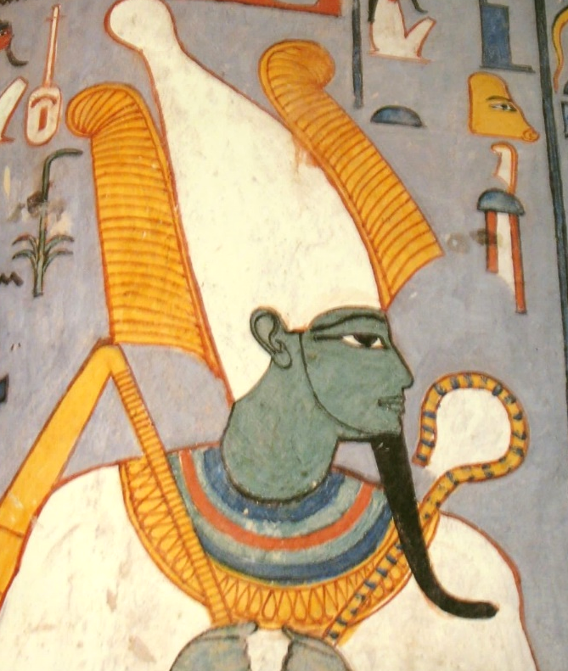
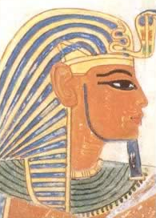
Notes:
Have the students put their pencils down – even if they aren’t finished with their hieroglyphics. They can finish their hieroglyphics after they see this next instruction.
Now its time to draw your God or Royal!
In a minute we will pass out a handout with several samples. One side has samples of different crowns worn by royals, the other side has samples of Gods and Goddesses. The crowns could have been worn by a male or a female – if they were in charge, they were a King (male or female!)

Slide 8
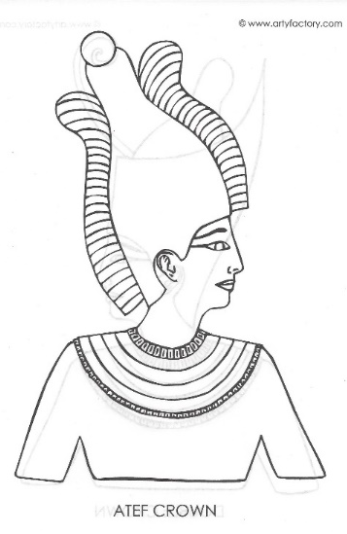
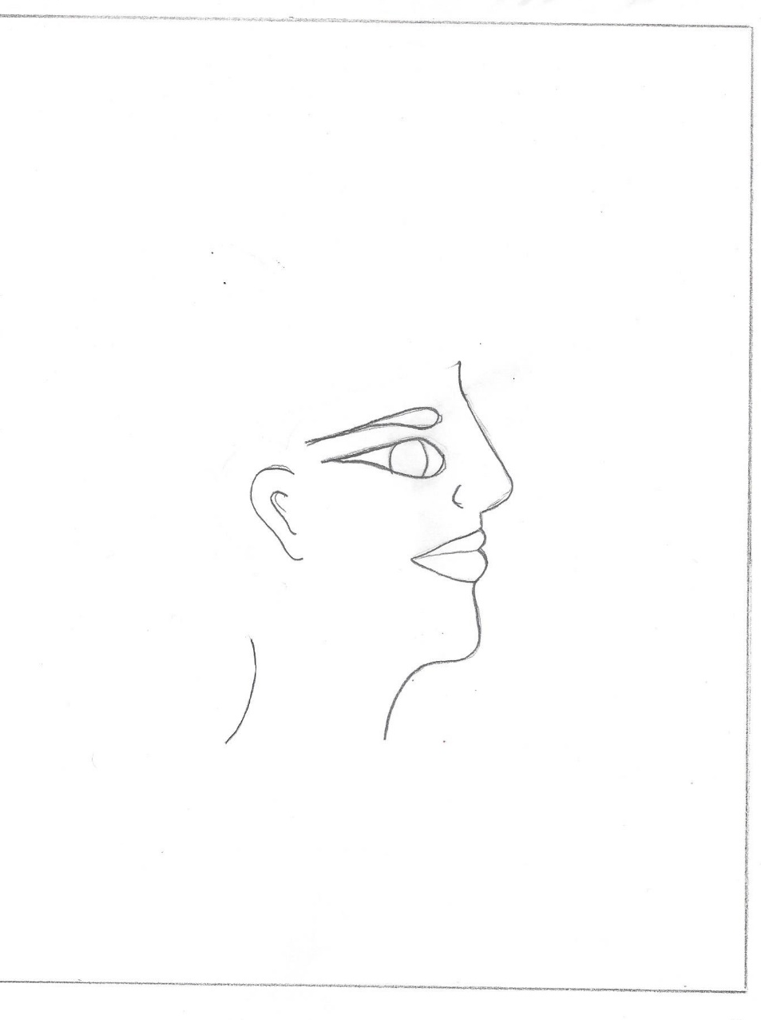
Portrait Drawing
Review Handouts
Choose Inspiration
Plan Your Space
Room above head for crown
Room below head
for upper body
Notes:
NOTE: Show students the God/Royal handout, but don’t pass it out yet … or else they will be staring at the samples, thinking about which one they want to draw instead of watching/listening to your instruction :0)
Once we pass out the handouts, look at the options and choose your inspiration, You are also welcome to look at posters in the room or in your textbook for ideas.
Plan your spacing before you start to draw. One approach is to start with the face, in middle of page… then add crown above and body below… others prefer to start with the shoulders and chest, then work their way up the page.

Slide 9
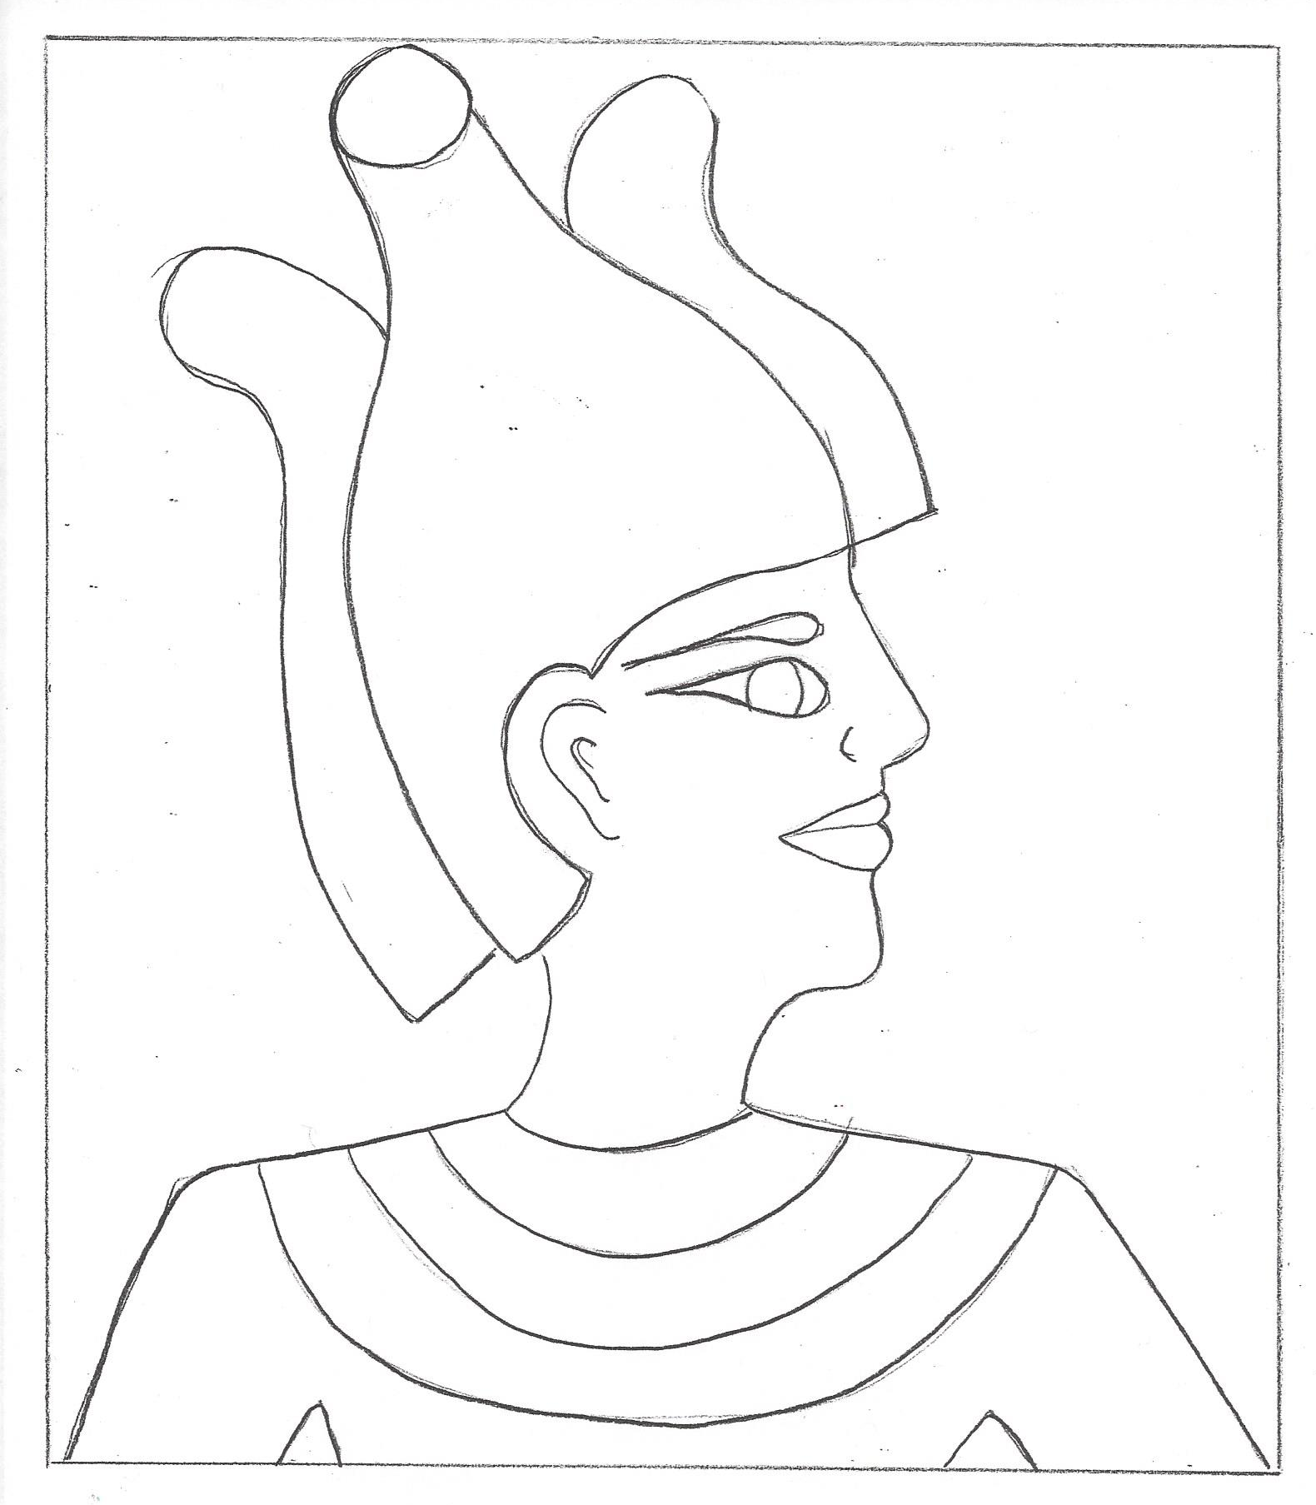
Stylized sketch
Lightly in pencil
Simple, not detailed
Face
Side view
Whole eye
Upper Body:
Front view
Collar Necklace
Outline main sections
Detail comes later
Notes:
Quickly go over the steps on the screen
Remind (a few times!) that they are doing basic outlines only, not adding detail at this point
Several of the samples include a scalloped design on the chest – they don’t need to this detailed pattern now! They can add this detail when we move on to the colored pencils.
Pass out the handouts of the Gods / Goddesses / Crowns
Leave this slide up while giving them 10 minutes to sketch

Slide 10
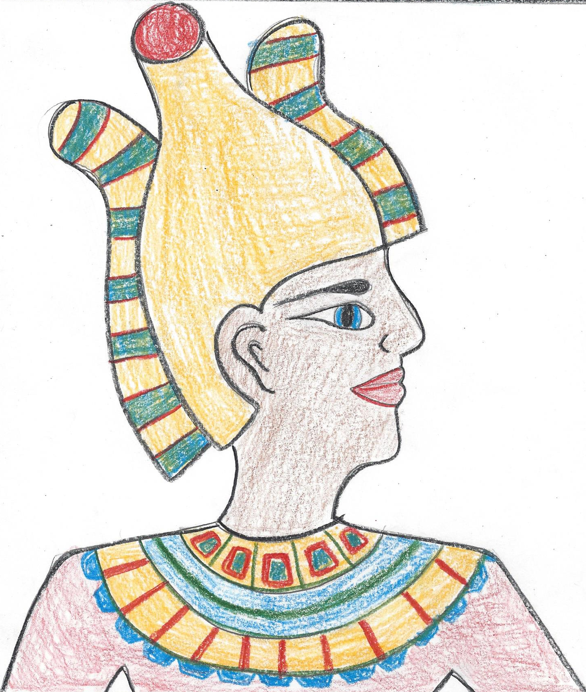
Add Color & Design
Crown & Necklace: Add pattern, designs
Skin Tone: Women lighter, men darker, gods (see samples)
Outline: Main features in black
Notes:
Get their attention again – pencils down! Even if they aren’t finished with their sketch (they can resume sketching after they see this next instruction).
Explain final steps: Color, design and finishing touches. Point out that if they spend a LOT of time on their sketch, they may not have time to color. It is a perfectly acceptable option to trace over your outlines with black, instead of coloring. It will look like a “weathered” artifact, carved in stone!
After instruction, pass out the colored pencils and color samples, leaving this slide up on the screen for reference while they work.
Try to minimize further “whole class” instruction – students can’t take in constant announcements while working. Instead, walk around and help one-on-one if needed.
Do provide time checks to the whole class every 10 minutes.
Collect all work (make sure name, teacher name & period on back!) a few minutes before the end of class – use final minutes for students to return pencils, colored pencils, erasers, sharpeners and handouts.

